Slide 1
Modern Finance at Microsoft
Lucas A. Meyer
Group Manager, ML and Analytics
Microsoft Corporation

Slide 2
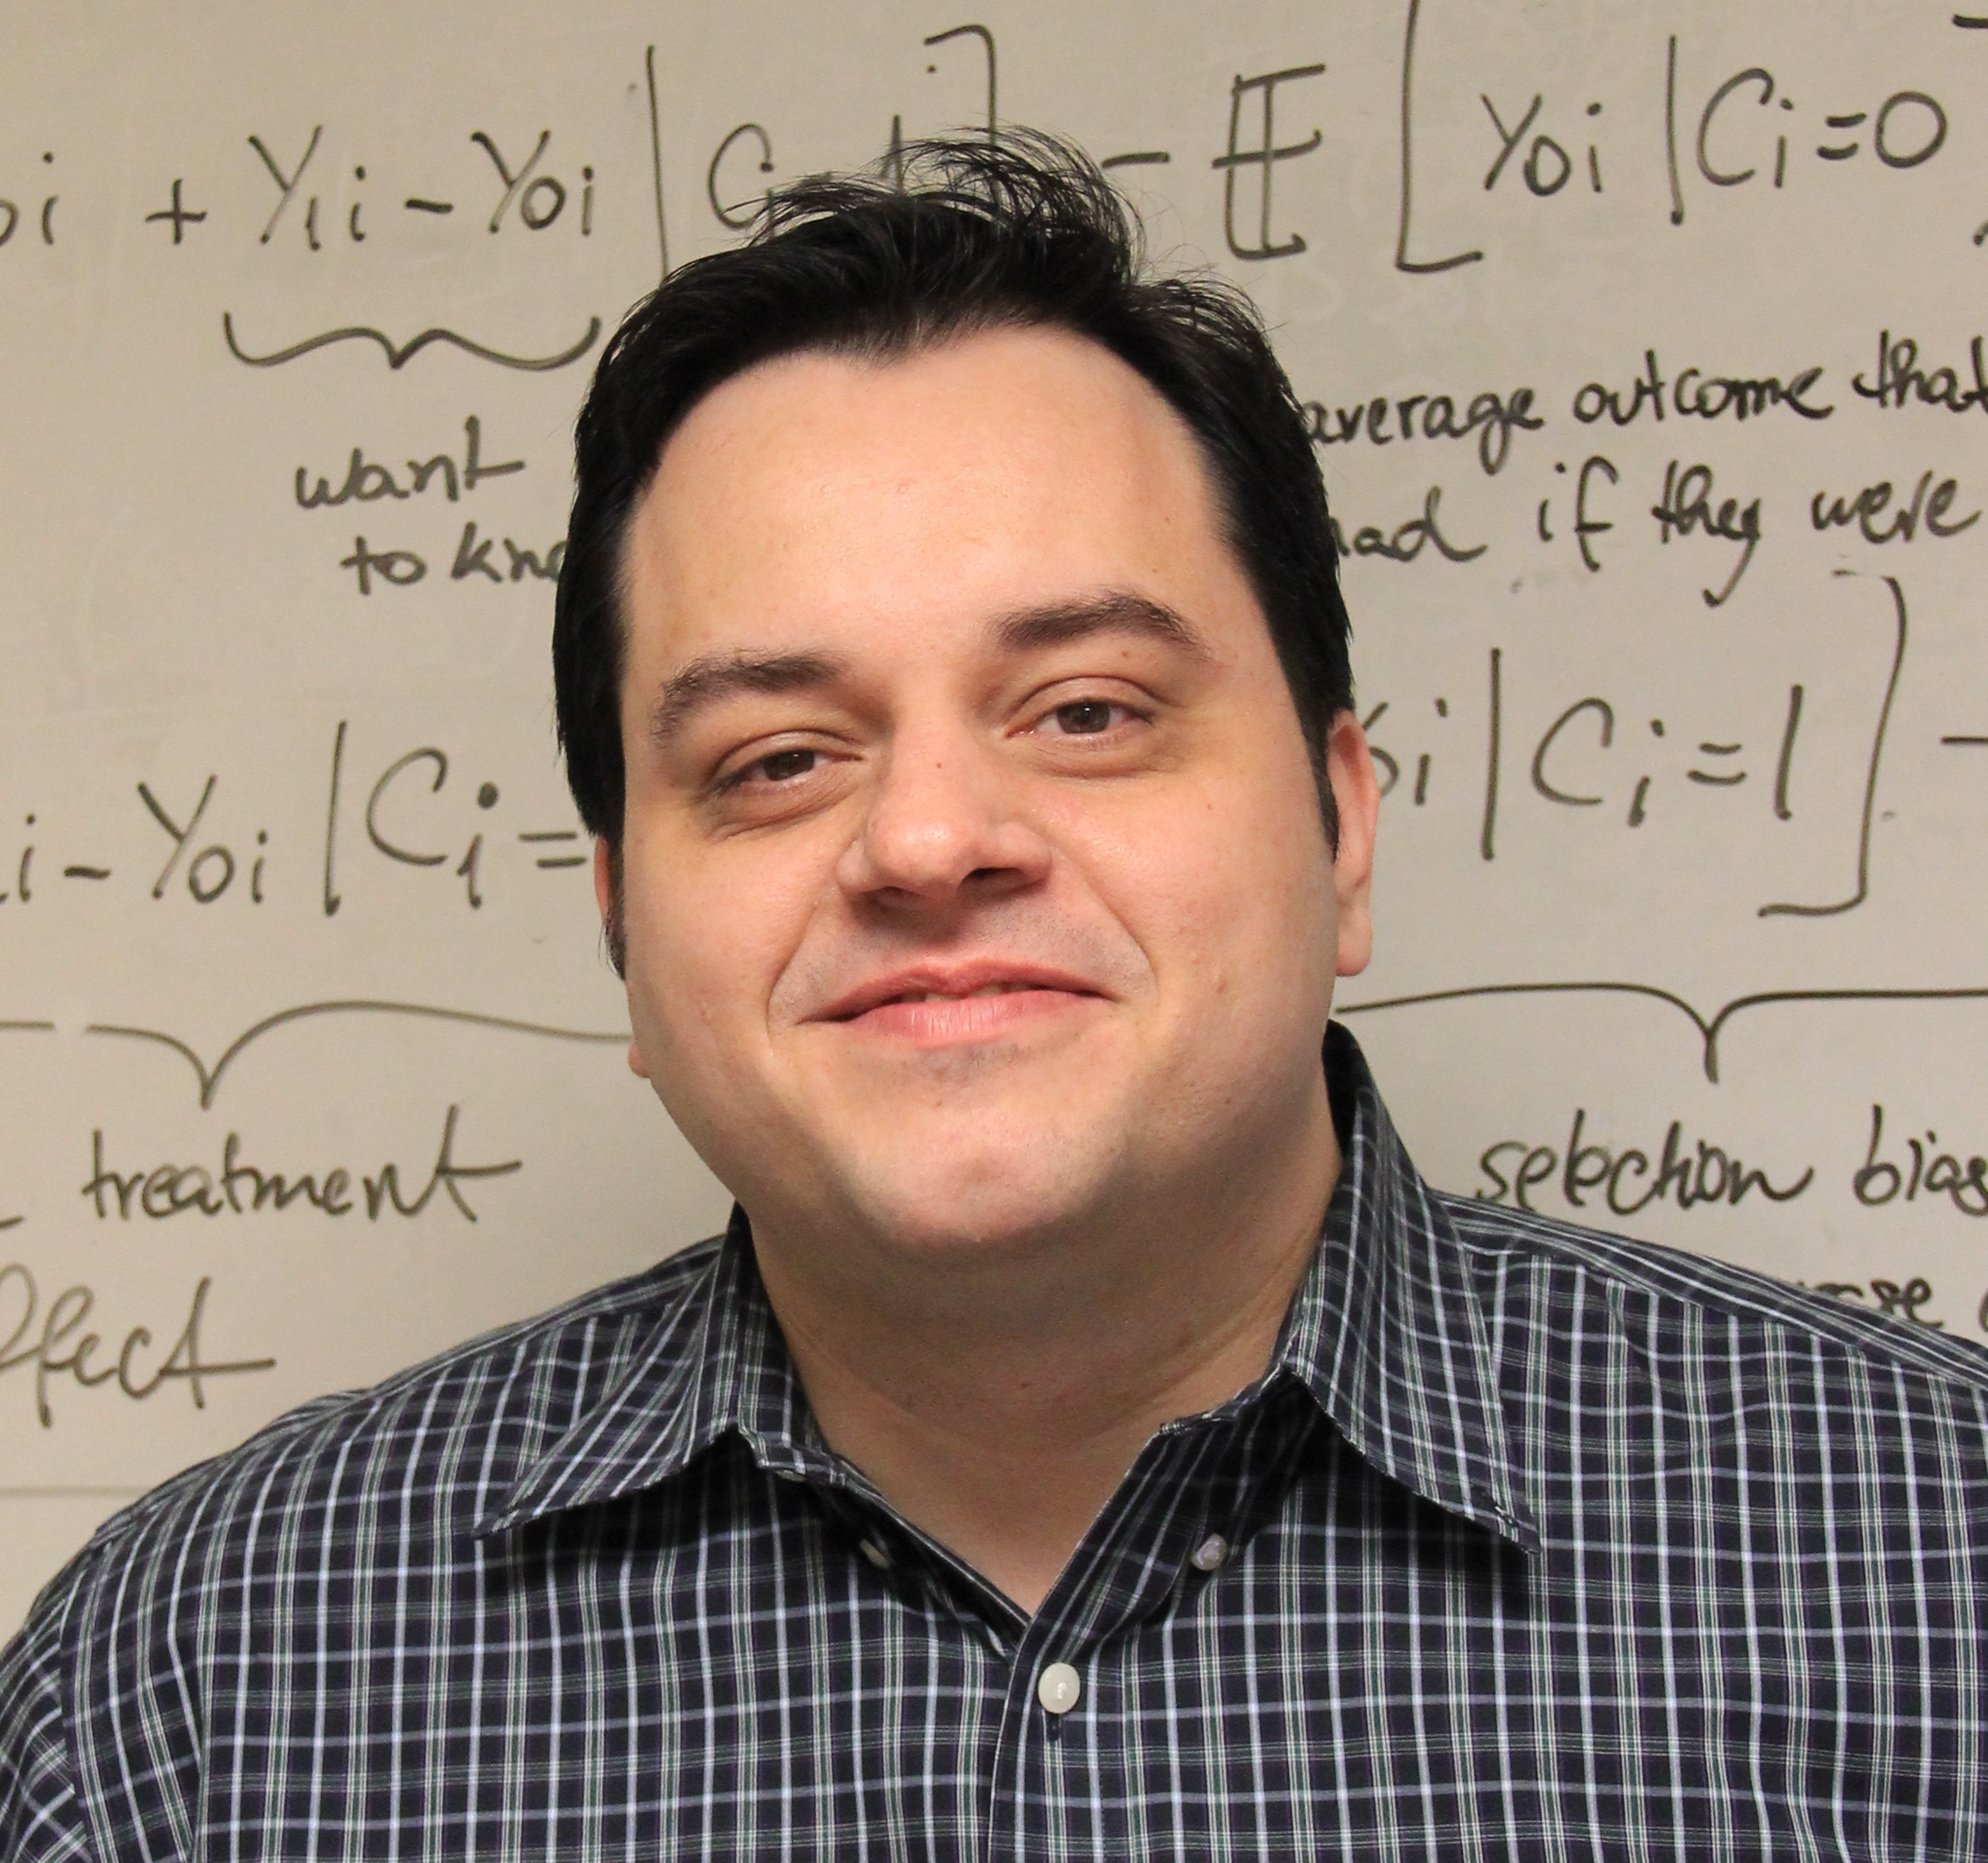
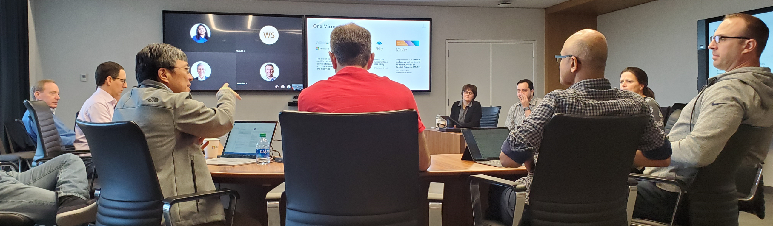
About me
B. Sc. Computer Sciences ‘01 (Universidade de São Paulo, Brazil)
University of Washington TMMBA’10, MSc Finance’14 (ABD)
At Microsoft since 2002
Twitter: @lucas_a_meyer
LinkedIn: lucasameyer
Email: lucas.meyer@microsoft.com

Slide 3
About Worldwide Payment Solutions
Collections
FY’19 $140B
> 20% YoY increase
>100k
Active
customers
65 FTEs
+1000 BPO
13 Global Locations
>90%
<0.05%
Current
Losses
Notes:
The World-Wide Credit Services organization is responsible for the management of Microsoft’s global credit risk and accounts receivable portfolio. Oversight for this $22 billion portfolio is carried out by teams based in Redmond, Reno, Fort Lauderdale, Manila, Buenos Aires, Dublin, Budapest, Chennai, Gurgaon, Johannesburg, Singapore, Seoul, and Beijing. World Wide Credit Services provides services for all of Microsoft’s major business segments in support of the order-to-cash-cycle and partners with the Treasury Organization to maximize cash flow in support of the lifecycle of the dollar.

Slide 4
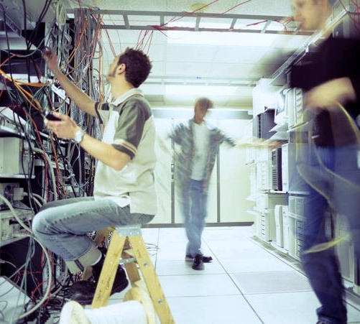

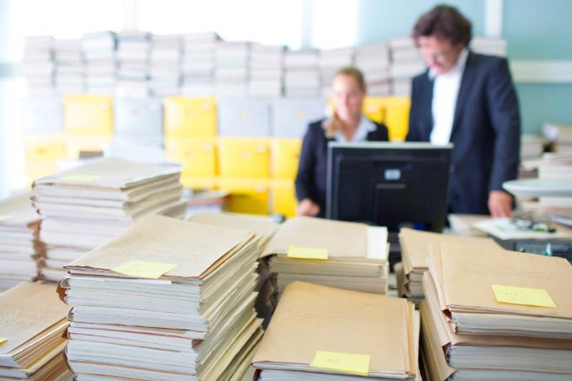

Today’s finance challenges
Surging data + legacy systems + static reporting
Inadequate tools to anticipate growing business complexity
Manual, inefficient and error-prone processes
Increasing regulations, risks, and threats
Notes:
When we talk to customer CFOs, here are some examples of the challenges they have and why they need Modern Finance
These challenges look all old, but the reality is that a lot of our customers are still struggling with these challenges
Some of these challenges are also part of our own Finance challenges in Microsoft:
Several of our Customers are still living with Legacy Systems created 20 years ago (In MS: BWB still around)
Using Static Reports and not able to drill down to find insights (In MS: Old MYR Decks)
Data is the new Strategic Asset for CFOs. The amount of data is doubling every year in the World and several of our customers have not yet created their “single source of the truth”
Business is becoming more complex every day, having old tools that were built for old business models is not helpful (In MS: New Business in MSS)
Several Finance Processes that our customers do are still manual. Sometimes the people managing these processes are great on what they do but subject to human error (In MS: Closing, Reconciliations)
Finally, as the world grows, there are new business risks and threats, there is a need for more regulations. We just can’t rely on manual processes, we need to develop our tools to proactively help us mitigate risks. (In MS: Old way to sample deals for Compliance Review)

Slide 5

Empowering finance employees
Time spent on various activities in Finance
Before
Activities / Responsibilities
After
Deep analytical and strategic thinking
Influencing and negotiating
Diverse project management
Advanced business knowledge
Operational thinking
Transactional expertise
Task management
Basic business understanding

Slide 6
Digital transformation journey
Business
Intelligence
What happened?
Static reports
Manual processes
Decisions
Why did it happen?
Interactive dashboards
Data
Advanced
Analytics
What will happen?
Predictions
Action
What should I do?
Recommendations
Is it repeatable?
Automation
Automation
Value
Notes:
Let’s talk now about the Digital transformation journey
[CLICK] The journey is about taking DATA and turning into ACTION, adding VALUE to the Business in the fastest and most relevant way.
But before we could do that, we had to work on preparing the DATA, cleaning up data, creating consistent taxonomies, moving it to the cloud, and creating the “single source of truth”. Many of our Customers are still in this phase.
[CLICK] Once DATA is clean and available we can now produce BUSINESS INTELLIGENCE.
In the beginning we started with STATIC REPORTS, that could only tell WHAT HAPPENED. They didn’t allow the drill down capability and didn’t produce insights for our Business. Furthermore, the amount of MANUAL PROCESSES and work that we had to put together to build these reports and then produce insights was huge
POWER BI came few years later, allowing interactive reporting, making meetings much more dynamic, helping us understand WHY IT HAPPENED, reducing the amount of Manual Processes, but still we could only look at the past and didn’t have the tools to help predict the future.
[CLICK] Then we crossed the line and start looking at the future with ADVANCED ANALYTICS.
With MACHINE LEARNING we can now learn from the past to predict the future, we can know WHAT WILL HAPPEN. The distance between DATA and ACTION is shorter now, the amount of MANUAL PROCESSES and human errors is lower now. Customers love this!
Finally with a combination of MACHINE LEARNING + BOTS we get to the position that we can say WHAT TO DO, automating the decision making process and moving really fast from DATA to DECISION.

Slide 7
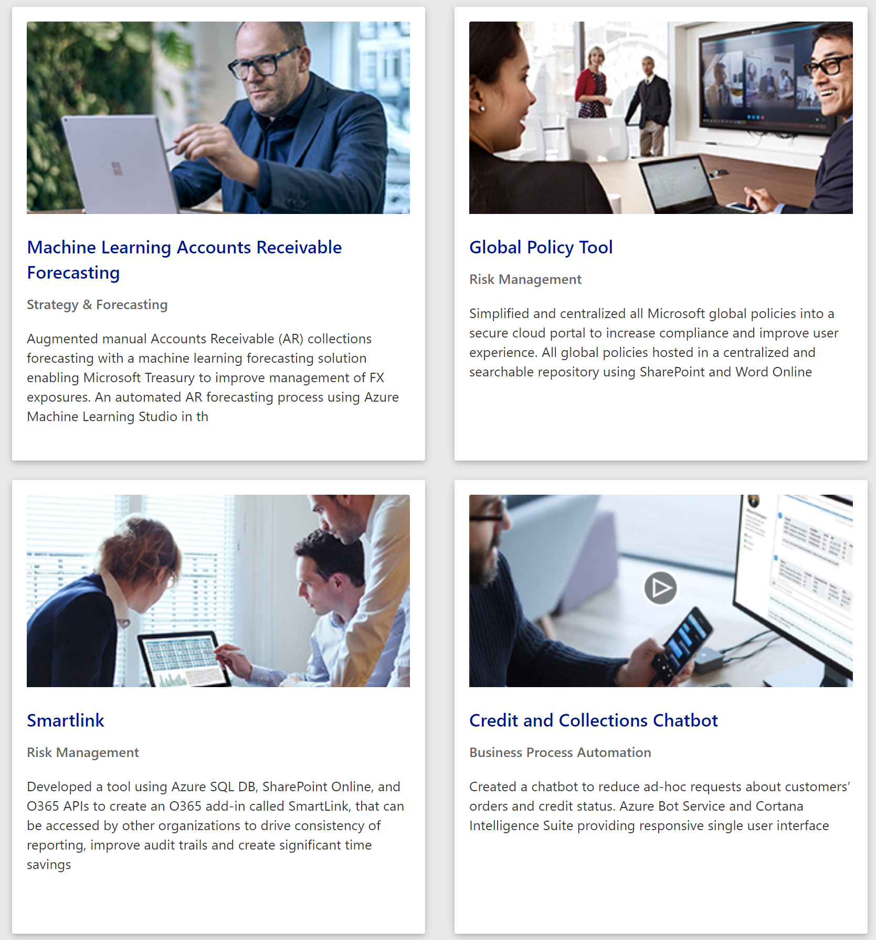
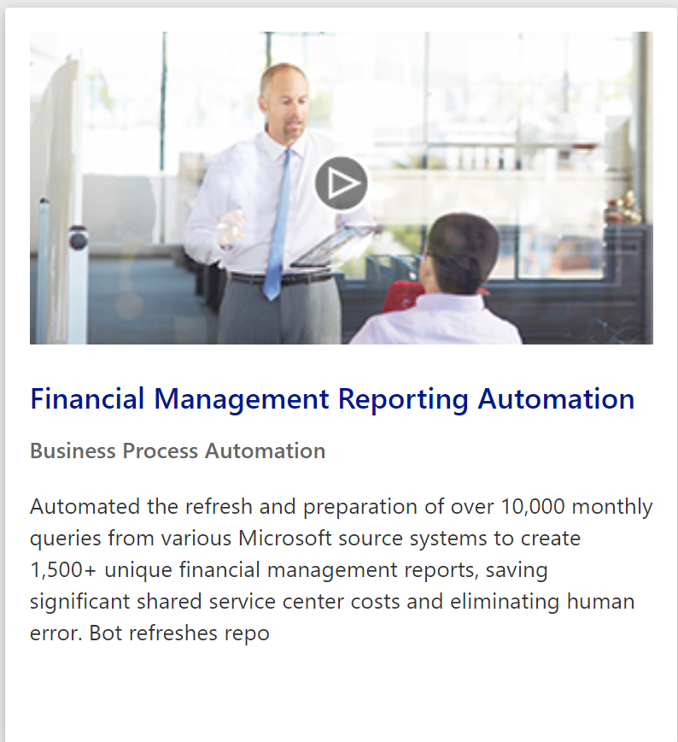


Modern Finance Portal
Besides improving the efficiency of Microsoft Finance, we also want to increase sales.
We created a Modern Finance Portal to:
Share solutions among finance teams
Provide material for sales teams

Slide 8

In my experience…
The main characteristic of a successful machine learning model are its economics
A machine learning model is either making/saving money or costing money
If you can show that your model has good economics, you’ll get plenty of resources

Slide 9



Example 1:
Improving forecasting accuracy

Slide 10
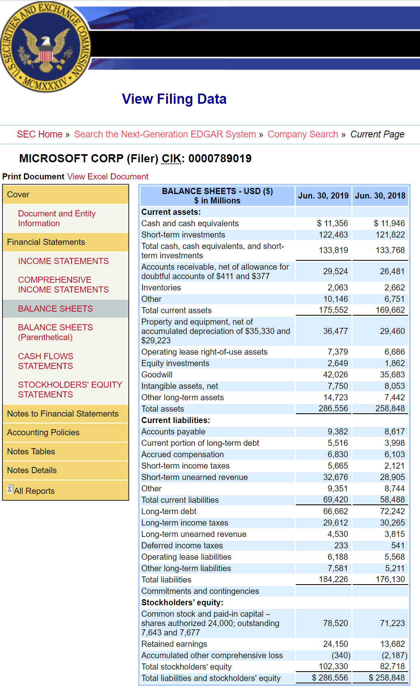
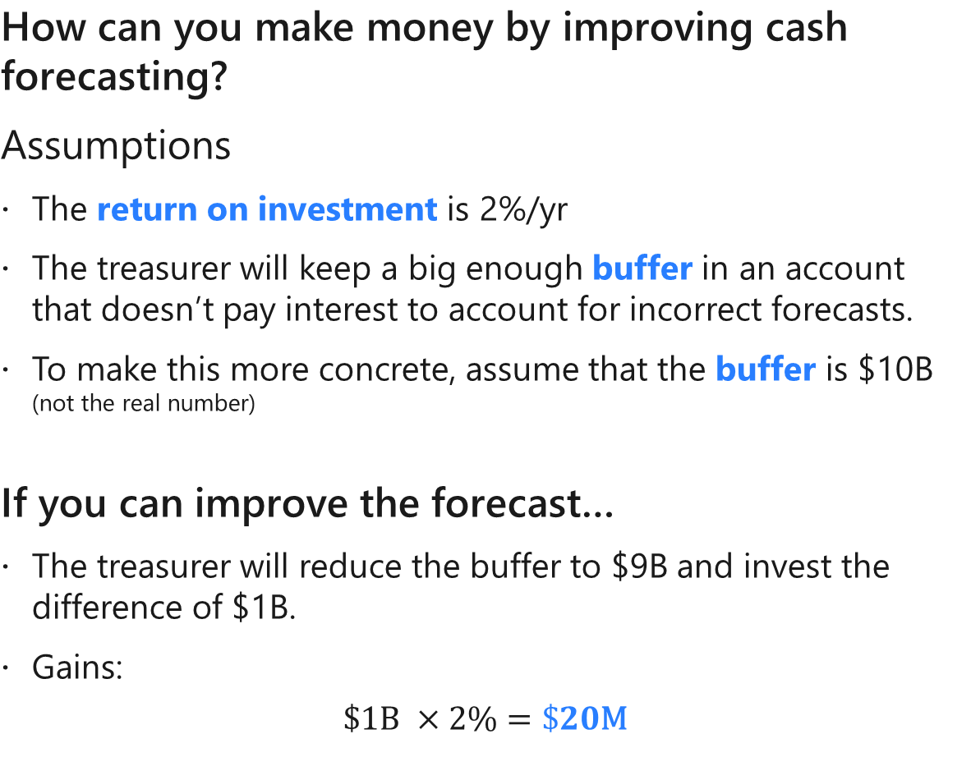
Motivation
How can you make money by improving cash forecasting?
Assumptions
The return on investment is 2%/yr
The treasurer will keep a big enough buffer in an account that doesn’t pay interest to account for incorrect forecasts.
To make this more concrete, assume that the buffer is $10B (not the real number)
If you can improve the forecast…
The treasurer will reduce the buffer to $9B and invest the difference of $1B.
Gains:
$$\$1\text{B} ×2\%=\$20\text{M}$$
Consequences:
Cost of capital: $54M @ 4%
Over 50k hours of rework cost
Lower customer satisfaction

Slide 11
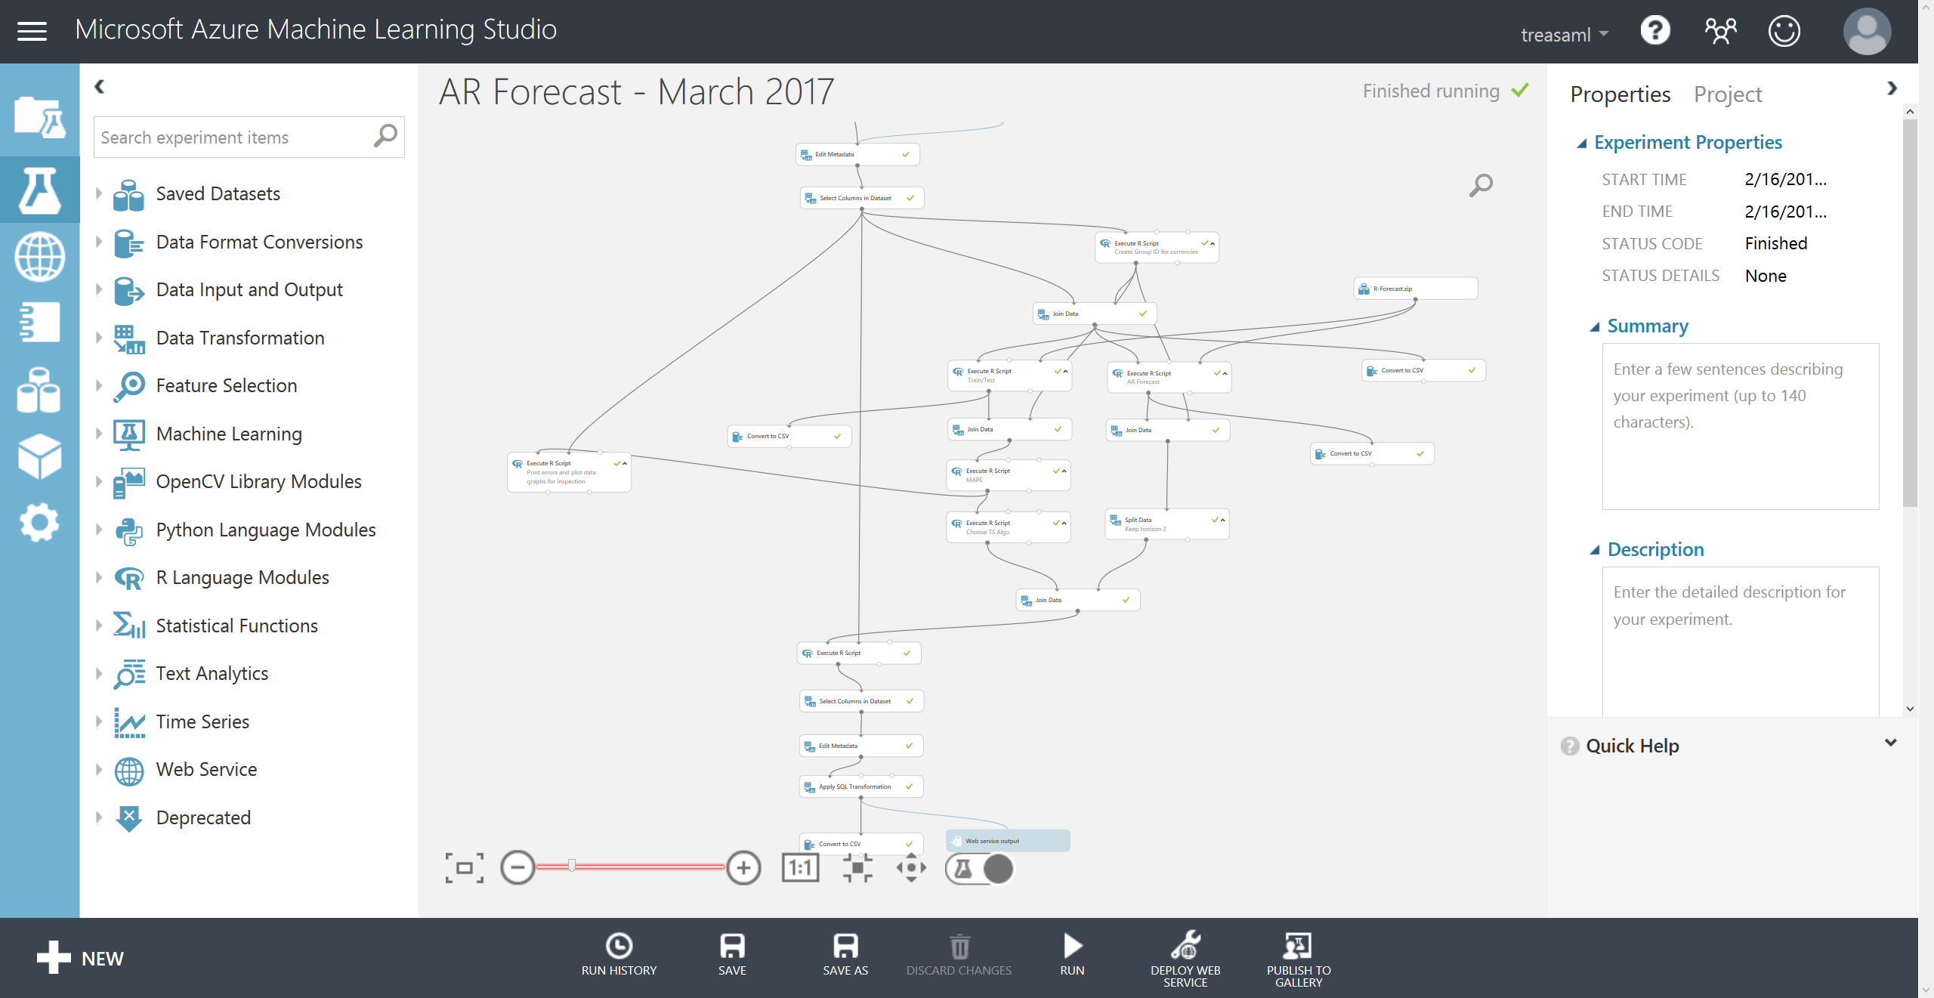

Transformation
Used model selection and hyperparameter optimization to find the best-performing model
Allowed treasurer to reduce buffer by $2B, resulting in a $40M benefit per year.

Slide 12

About “weak baselines”
It’s possible that the only reason why the buffer could be reduced by a large amount was because the old forecasting method was bad.
It’s likely that even an unsophisticated model will beat a “weak baseline”.

Slide 13
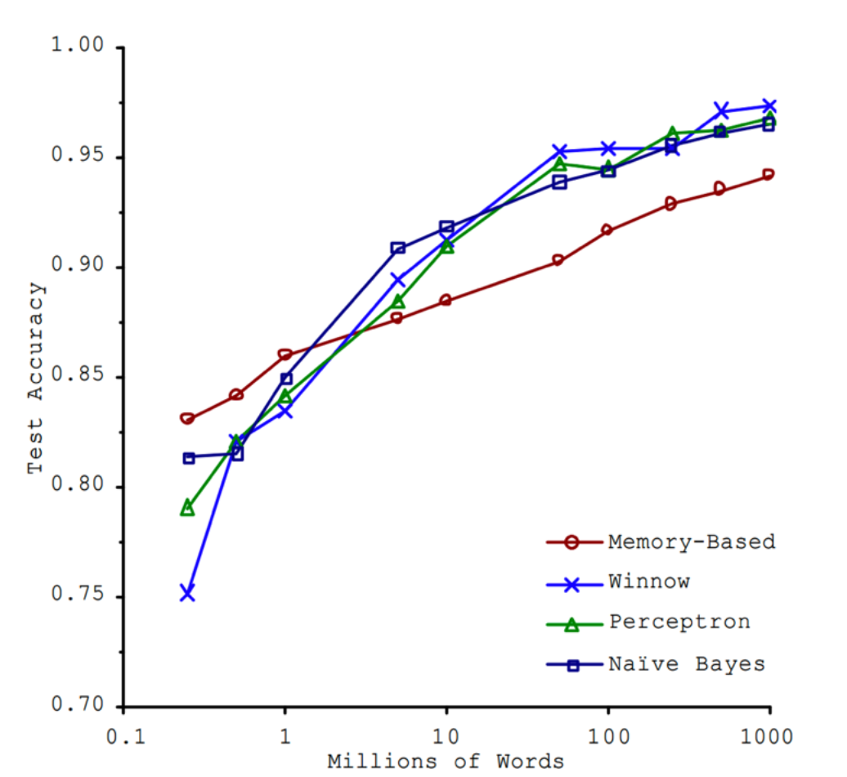
About “the unreasonable effectiveness of data”
The more data you have, the better your project will perform, even if you don’t choose the best algorithm.
The terminology changed over time:
Memory-based: e.g. KNN
Winnow: optimized perceptron
Perceptron: early neural network
Naïve Bayes: you probably know it
Source: Banko, Brill (2001) – Microsoft Research

Slide 14

Choosing successful projects
You have enough data
You know the baseline and think you can beat it
Beating the baseline provides economic value far in excess of the cost of your project
You should do it.

Slide 15

Example 2:
Predicting errors in invoices

Slide 16
Motivation
Enterprise Volume Licensing is a large portion of our sales…
$52.2B sold in FY18 and $59.1B in FY19
400k invoices in FY18 and 472k in FY19
… but many Enterprise VL invoices are credited and rebilled:
In FY18, 10.8% of the VL invoices were credited and rebilled, representing 18.6% of the amount ($9.7B)
Consequences:
Cost of capital: $54M @ 4%
Over 50k hours of rework cost
Lower customer satisfaction
Day 30 Invoice due
Day 51 Invoice reissued with 30-day terms
Day 81 Reissued invoice is due
Day 0 Invoice issued with 30-day terms
Day 30-51 Find and fix the issues
51 days Delay in cash receipts

Slide 17
Project goals
Fixing root causes of invoice errors will take time.
By using machine learning:
We might be able to mitigate the issues by predicting likelihood of errors and shortening the time it takes to correct them
We can identify potential root causes by finding the most predictive features

Slide 18
A complex problem with diverse data:
Our dataset was 1.6M invoices and over 200 variables from the last 5 years.
Customer signs an agreement with Microsoft
Customer issues a purchase order
Microsoft sends customer an invoice
Email/calls between customer and Microsoft
Customer makes a payment
Industry
Geographical location
Direct/through a partner
New/renewed
# of amendments
Manual/electronic PO
# of concurrent POs
# of lines
Amount
Payment Terms
Close to end of year?
Free text, e.g.,
“Hi team, invoice 9877495478 seems to be missing a discount. Expected HWN-00002 - VisioOnlnP1 ShrdSvr ALNG SubsVL MVL unit price 2.36"
Past payment behavior

Slide 19
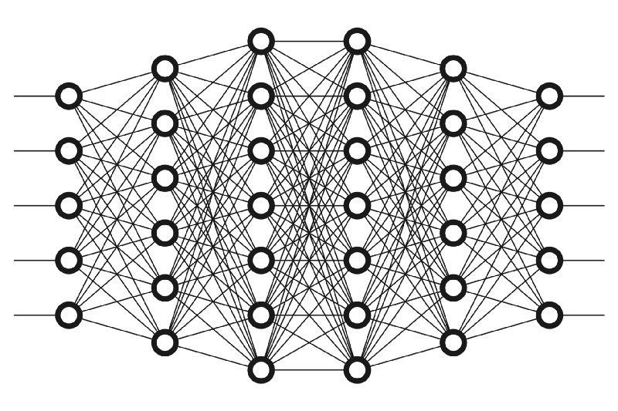
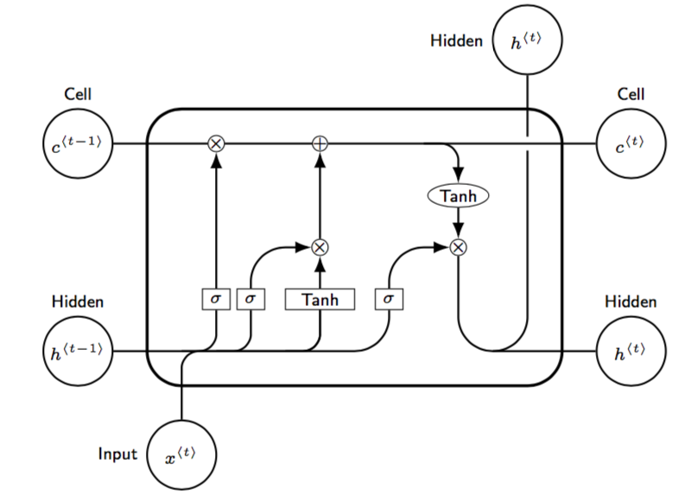
Invoice processing through Beaker deep learning models
Invoice
Sent for review
1
Beaker tabular is a deep neural network that can flag potential errors immediately
It is optimized for precision (90%): we want to avoid false positives
Detects 61% of invoices with issues (recall)
After a week, we run the Beaker NLP model on accumulated emails and call transcripts to catch errors that may have been missed
Precision 66%, recall 49%
Issue?
Yes
1
Beaker Tabular DNN
No
Wait 7 days
2
Issue?
Yes
2
Beaker NLP
No

Slide 20
Implementation
Final model was deployed in August 2018 (FY19-P02)
Savings to date: $20M
Flagged several large invoices that had problems, enabling us to fix errors earlier
Beaker
Day 0-13 Beaker helps us find and fix errors
Day 30 Original Invoice due
Day 43 Average invoice due date with Beaker
Day 81 Average invoice due date without Beaker
Day 0 Invoice issued with 30-day terms
13 days
Delay after Beaker
51 days Delay before Beaker

Slide 21
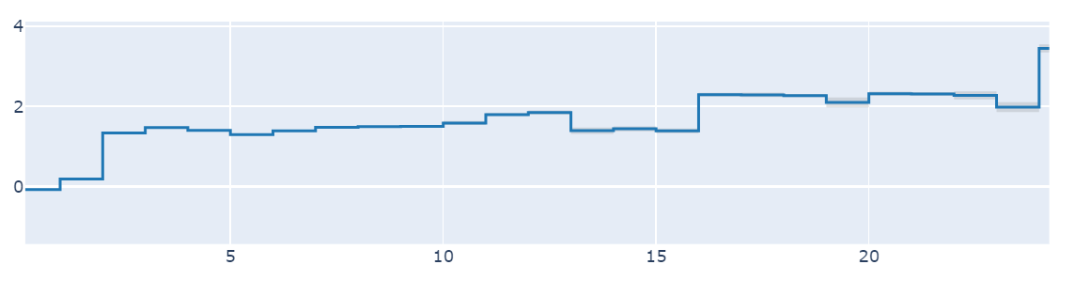
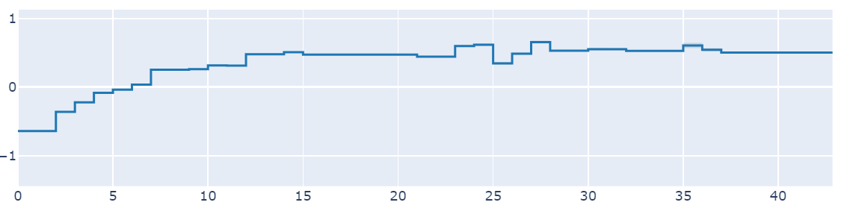
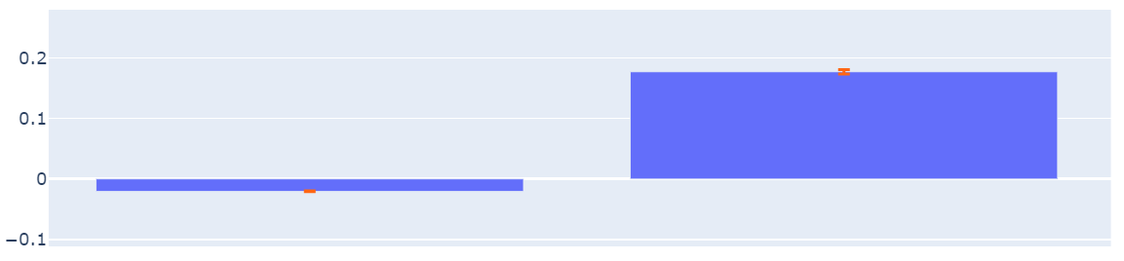
Project Beaker – Insights
We used explainable models to help Operations and Commercial Finance prioritize where to focus when changing credit and rebill processes and policies.
Interpret package from MSR, Samuel Jenkins, Harsha Nori, Paul Koch, and Rich Caruana
Risk score
N
Y
Number of pages
Number of amendments in agreement
Contains Azure
Longer invoices are more likely to have issues
Issues are more likely in invoices for contracts that have complex, non-standard agreements
Volume licensing invoices that contain Azure are more likely to have issues
Since we finished our project, credited invoices are down 40%

Slide 22


Thank you!

